Slide 1


JUDGING SPEECH AND DEBATE

Slide 2





Thank You For Taking The Time To Judge
  Your feedback is incredibly valuable!​
  Judge the performance - not the uncontrollable factors​
  Take notes during performances - either on the Speechwire feedback pulldown or notepad to transfer later​
  Write speciﬁc comments to praise and help the competitor and their coach to improve​
  You may want to write saved feedback on a Google doc and paste into Speechwire feedback pulldown

Slide 3



Important General Information
  Google Chrome required for Speechwire software​
  If you have a ballot, it should appear on your screen. It will have the names/codes of the competitors and the start button. Click START​
  If you do not have a ballot, stay in the judge lounge until the tab releases standby judges. If your name is called as a replacement and you are not present, your school will be ﬁned.​
  Please be aware - all of us have implicit bias… a way that we see the world. Judges need to set this bias aside and listen to the speeches and debates with a fresh and open mind!

Slide 4

Speech Ballots
  Hit the start button to let tabroom staff know.​
  Start round at the scheduled time.​
  DO NOT wait until all students are present. Many are double-entered.​
  If Extemp or Impromptu, they come in one at a time.​
  Take notes during performances to provide detailed comments to the kids.​
  Rank performers 1st, 2nd, 3rd, and so on… Write detailed comments!​
  If the tournament is using speaker points, the range is 90-100. 100 = awesome, 90 = not so much...

Slide 5
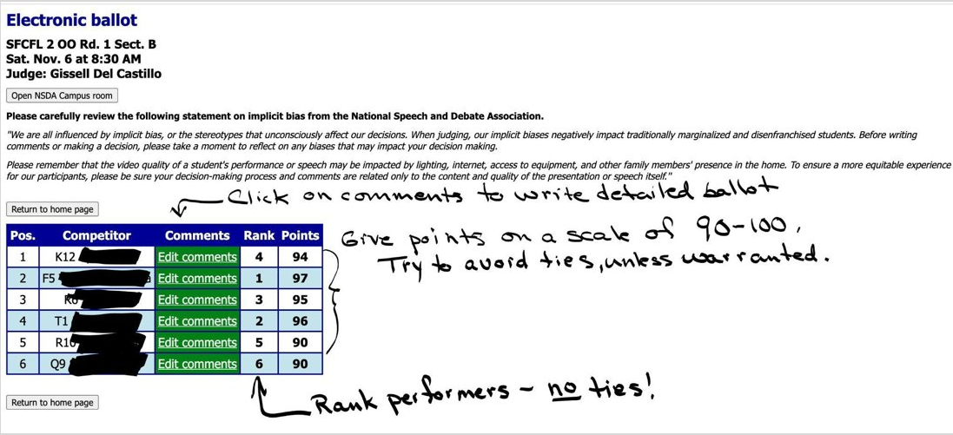


Speech Ballot Ranking and Points

Slide 6
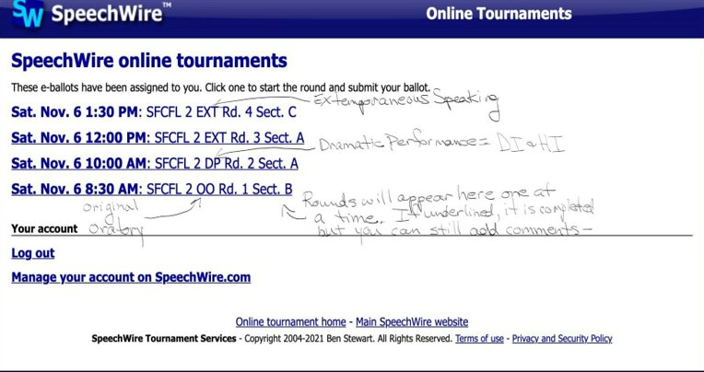
SpeechWire Speech Judges
  Once you log in to live.speechwire.com, this screen will inform you if you have a ballot​
  They will layer as the day goes on.​
  Click on the link to start; after the round is over, rank your speakers and give points, and save/submit.​
  You can revisit your comments section later to add more comments.

Slide 7
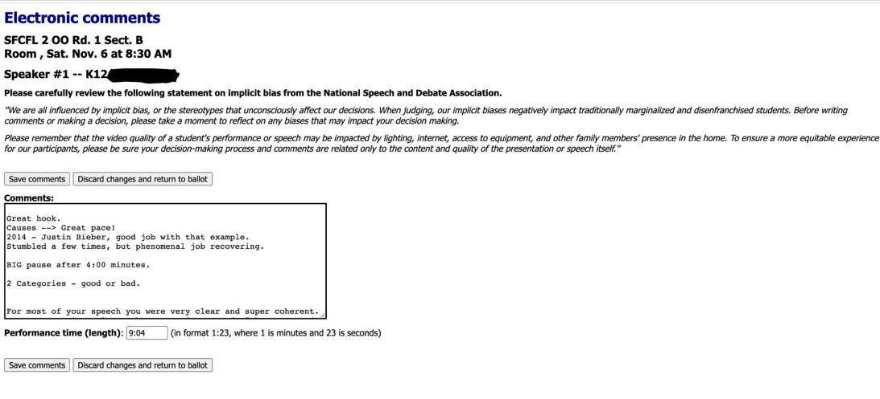
Speech Ballot Writing Comments

Slide 8
Speech Events
Limited Preparation Events
  Extemporaneous Speaking
  Impromptu
Rhetoric Events
  After Dinner Speaking (ADS)
  Informative Speaking
  Original Oratory
Interpretation Events
  Dramatic Interp
  Duo Interp
  Humorous Interp
  Program Oral Interp

Slide 9

Extemporaneous Speaking
What is it?
  7 minute speech with 30 seconds grace (NO PENALTY) You should time speech with stop watch on your phone - NOT the wall clock!! Ask the student how they would like you to give time signals.​
  Should answer and analyze a question they received 30 minutes prior​
  Speaking extemporaneously without notes or script​
  They enter one speaker at a time. They may stay and watch after they are ﬁnished, but they do not have to.​
  They should read the question to you before their speech and hand you the prompt (not hold in hand).

Slide 10

Extemporaneous Speaking
Speech should:​
  Answer the question​
  Have solid organization that is easy to follow​
  Contain cited sources when needed for support​
Speaker should:​
  Communicate with the audience with eye contact, gestures, and vocal variety including pace, pitch, inﬂection, and energy​
  Use a ﬂoor pattern to separate sections of the speech​
  Demonstrate clear knowledge of the topic​
Judge
  The judge should time the speech, take notes, and write feedback on the pulldown​

Slide 11
Ballots For Extemporaneous Speaking
  Students work hard! They need speciﬁc feedback so they can improve
Identify what the student did well:
  “Great hook at the beginning of the speech!”​
  “Thank you for explaining the background. It gave me a better understanding.”​
  “Super job previewing the organizational pattern; it was very helpful”​
  “Nicely cited sources.” “Great use of Tom Friedman to explain econ!”​
  Great point on why this is important in the world today”​
  Great vocal inﬂection. Your voice told me what was important!​
  Nice use of transitions between each point.

Slide 12

Ballots For Extemporaneous Speaking
Identify what the student did not
do well or that needs work:​
  “You asked the question but didn’t really answer it in your analysis”​
  “Can you explain or give an example in your second point?”​
  “I am not following the logic of your argument. Needs to be better thought out.”​
  “Do you need your hand gestures throughout? They are a little distracting. Be okay with leaving them at your side.”​
  “Try to vary your tone (monotone). Try to entertain your audience.”​
  “Vary your intensity, not everything has the same importance.”

Slide 13


Impromptu Speaking
What is it?
  Students have 7 minutes to select, analyze, organize, and present a speech from start to ﬁnish.​
  There is no perfect balance between prepping and speaking (2 minute prep/5 speak, 4/3, etc)​
  Judge will be given Impromptu prompts to provide to students for their selection process.​
  Student speaks extemporaneously without notes or script​
  They enter one speaker at a time. They may stay and watch after they are ﬁnished, but they do not have to.​
  They should read the prompt to you before their speech and hand you the prompt (not hold in hand).

Slide 14

Impromptu Speaking
Speech should:​
  Address the prompt​
  Have a solid organization that is easy to follow
Speaker should:​
  Communicate with the audience with eye contact, gestures, and vocal variety including pace, pitch, inﬂection, and energy​
  Use a ﬂoor pattern to separate sections of the speech​
  Demonstrate clear knowledge of the topic
Judge
  The judge should time the speech, take notes, and write feedback on the pulldown​
  See the section on Extemp Ballots for ideas of what to write on a ballot.

Slide 15

After Dinner Speaking
What is it?
  ADS is an informative and entertaining memorized speech of 8 minutes​
  with a 30-second grace period (no penalty). The primary purpose is to entertain.​
  The speech should have serious undertones with a thesis and demonstrate clear organization.​
  No notes or script may be used.​
  No Visual Aids are allowed.​
  Humor is very subjective. Please be open-minded, but if you ﬁnd something overtly offensive or inappropriate, let them know in your comments… NOT by telling them they are BAD!​
  Be sensitive to the fact that these are young people trying a NEW event!

Slide 16
Informative Speaking & Original Oratory
  Ten-minute speech with 30-second grace (no penalty!!)​
  OO should persuade the audience of something that is important to the speaker. Sometimes, it is an issue or problem regarding the world or society. But the topic is totally up to the performer.​
  Info should inform the audience of something that is important to the speaker. The topic can be anything! It is the presenter’s job to make the topic interesting and fascinating to the audience. The presenter may (or may not) use non-electronic visual aids to clarify, illustrate, and/or show the audience various aspects of the topic. Props are also allowed.

Slide 17
ADS, Informative Speaking, and Original Oratory
Speech should:​
  Be organized and easy to follow​
  Be relatable to the audience​
  Reference sources when needed for support (not rigidly cited)
Speaker should:​
  Communicate with the audience with eye contact, gestures, and vocal variety including pace, pitch, inﬂection, and energy​
  Use a ﬂoor pattern to separate sections of the speech​
  Demonstrate clear knowledge of the topic
Judge
  The judge should time the speech, take notes, and write feedback on the pulldown​

Slide 18

Ballots for ADS, Info, and OO​
Identify what the student did well:
  “I love the opening energy you bring to your topic!”​
  “This is fascinating! Thank you for voicing your concerns so persuasively!”​
  “Super job previewing the organizational pattern; it was very helpful.”​
  “Great use of experts who support your thesis.”​
  “Great point on why I should care!”​
  “Your solutions were clear and well thought out.”​
  “Wonderful job tying back to your introduction at the end! Nice!”

Slide 19
Ballots for ADS, Info, and OO​
Identify what the student did not do well or needs work:
  “I’m a little confused. You are at the two-minute point, and I am not sure of your topic. Can you present the thesis earlier?”​
  “Instead of connecting everything to suicide or crisis, are there different levels of consequences of the problem?”​
  “Can you explain why people act that way? Is the problem psychological or physical?”​
  “Hand gestures are important, but you seemed to get stuck just hanging up there like claws! Can you relax your hands? Keep them at your sides?”​
  Varying for tone and inﬂection would help polish the presentation.”

Slide 20

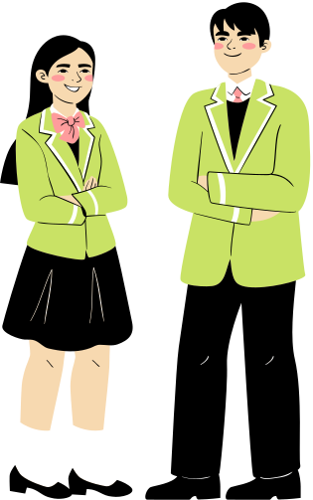

Interpretation of Literature Events
The purpose is to transport the audience into the world of the literature and reveal a greater truth! Entertainment with an artistic argument! Memorized with movement.
  Dramatic Interp (DI)​
  Humorous Interp (HI)​
  Duo Interp (DUO)​
  Program of Oral Interp (POI)​
  10 Minute performances with 30-second grace (no penalty)

Slide 21

Interpretation of Literature Events
Performance should: :​
  Follow a clear storyline. The story arc builds to a climax.​
  Be relatable to the audience.​
  Have emotional appeal – good DI includes humor, and good HI includes serious messages!
Performer(s) should:
  Use the tools of vocal variety (pitch, pace, etc), accents, sound effects, character voices, and silence for effect​
  Use physicality and movement to maximize the message​
  Connect with the audience to transport them to the world of the literature​

Slide 22

Interpretation of Literature Events
  Program of Oral Interp (POI) – the performer uses a binder/script. It can be used as a prop. Movement and use of space are a plus.​
  POI – presents a variety of different types of literature – plays, poetry, song lyrics, ﬁlm scripts, government documents… published work.

Slide 23
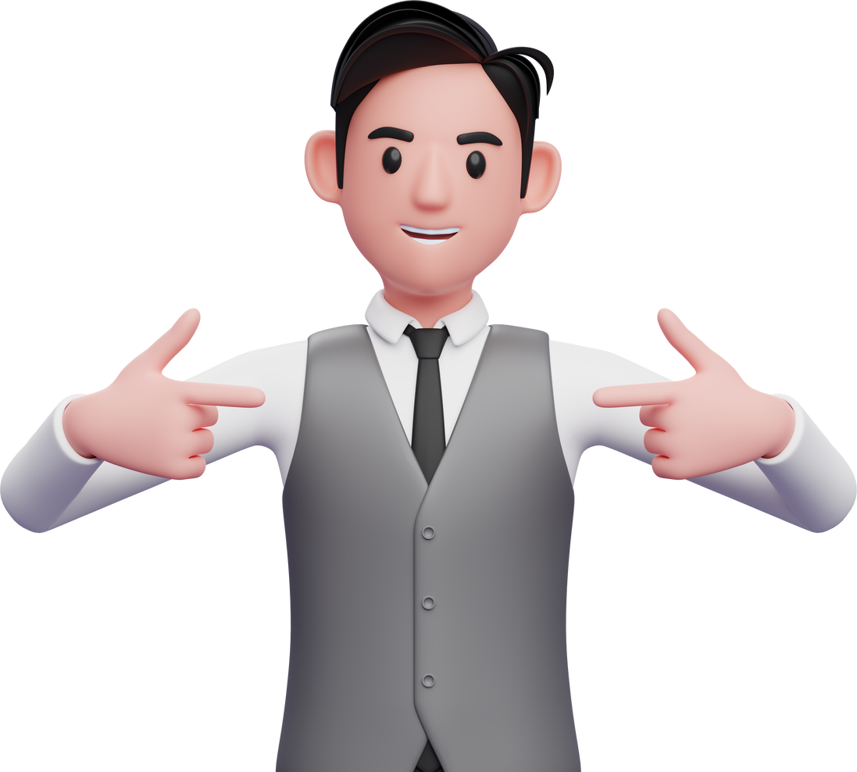
Ballots For Interp
Identify what the performer did well:
  “I love the opening moment! When you slowly turn to face us… wow!”​
  “Nice use of pantomime to establish your character is in the kitchen.”​
  “Loved the quotation at the beginning of your introduction.”​
  “This is a really important issue. Thank you for bringing it to our attention.”​
  “Wow, great job keeping characters separate and easy to follow!”​
  “Use of sound effects was really cool! How do you do that?”​
  “Thank you for not screaming. Sometimes less is more.”

Slide 24
Ballots For Interp
Identify what the performer did not do well or that needs work:
  “I’m uncertain of the opening pantomime. What is your character doing?”​
  “You have a lot of characters. How might you make that more clear? Posture? Face? Gestures? ”​
  “Your accent tends to fade in and out. Work on consistency.”​
  “Nice moment at the climax, but you rushed right out of it. A moment of quiet might help the audience to feel the moment.”​
  “The story was confusing to me. I’m not sure how scenes connected.”

Slide 25

What NOT To Write On ANY Ballot!​
Students work hard!​
  They do not need criticism on things that may be out of their control
Avoid the following:​
  “You need to wear a suit!”​
  Your voice is too shrill.​
  “Your skirt is too tight” or “You should wear make-up”​
  “I disagree. I work in banking and I know that is not true”​
  “That is ridiculous. No one believes that” “That is stupid.”​
  You’re obviously cheating.” (If you feel there has been a rule infraction, bring it to the tab room immediately! Say nothing to students or others.)

Slide 26


Important Reminders
  Judge is the ofﬁcial timekeeper. Please record speech times on their comments.​
  After you have ranked and given points, be sure to hit the submit and/or save button.​
  Double-entered students should identify that they are double-entered. Move the DE kids earlier in speaker order and allow them to leave or admit late. Don’t wait to start round! DE WR (will return) students are performing elsewhere.​
  If you think there is a rule infraction, rank the round as if there were NO infractions. Then, come to the tabroom and let them know what you observed.​

Slide 27
Before Submitting Speech Ballots
  Rankings: No ties​
  Speaker points (rates): 90 - 100. 100= AWESOME! 90=Need considerable improvement.​
  Avoid ties in speaker points if possible. But for sure, a weaker rank should no have higher speaker points than a stronger rank.​
  You may go below 90 if the performance was offensive or extremely rude in some way. Be sure to justify your scores by explaining in your comments.​
  You need to submit ballot with ranks and points ASAP, but we encourage you to continue writing detailed comments through the weekend!

Slide 28



Debate Events
Congression Debate
Lincoln Douglas Debate
Public Forum Debate
World Schools Debate
Policy Debate
Big Questions Debate

Slide 29



Congressional Debate
  Role Play Debate - competitors are playing the role of legislators in Washington D.C. Congress​
  Speeches are 3 minutes long (presiding ofﬁcer times all speeches and questioning periods)​
  Analysis should be well researched, and sources provided​
  Competitors will elect a presiding ofﬁcer at the beginning of each session​
  Speeches should be organized, with clear introductions, arguments, and clear positions on legislation. Speeches should not merely​ re-hash or repeat other arguments but should move the debate forward.​

Slide 30
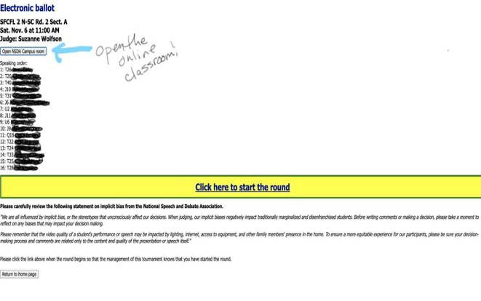
SpeechWire
You Have A SC Ballot
  Hit Start the Round. Then Open the classroom.

Slide 31
Congressional Debate
  Kids work hard! They need comments that will encourage them to do their best and to improve! Write comments for each speech.​
  Give speciﬁc examples: Great introduction; the power of your voice was perfect.​
  Good attention-getter, but you forgot to tell us your thesis. What is the point of this speech?​
  You did a great job with research, but a speech might do more than just list statistics… what do the statistics mean?​
  Good job identifying the weaknesses in other speakers’ arguments.

Slide 32
Congressional Debate
  Judge Duties:​
  The judge listens and takes notes on the debate, scoring each speech that is presented.​
  The judge scores each speech. Please use a range of 3 -6 points. 3 = poor; 6=great! The judge also scores the presiding ofﬁcer (per hour) for their job in keeping the debate running efficiently and effectively.​
  The judge will write comments for each speech and for the presiding ofﬁcer.​
  After the entire session is over (should be around 2 hours, rank the competitor's 1st place, 2nd place, and so on. DO include the presiding ofﬁcer in your rankings if they did a great job!

Slide 33
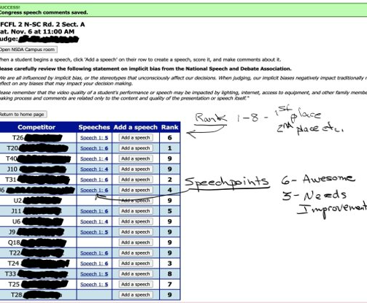
Submit Your Congress Ballots
  Each speech should have a score.​
  6 = Awesome!​
  3= Needs improvement…​
  Students are ranked 1-8​
  Please include your Presiding Ofﬁcer (PO) in your ranking choices.​
  Submit Ballot

Slide 34


Lincoln Douglas Debate
  One-on-one debate, debating a resolution provided by the national office.​
  Afﬁrmative speaker goes ﬁrst and presents a 6-minute speech establishing why the resolution is a true statement.​
  Negative speaker questions for 3 minutes and then presents a 7-minute speech attacking the afﬁrmative and presenting a negative position.​
  Afﬁrmative speaker questions the negative speaker for 3 minutes.​
  Aff then presents a 4-minute rebuttal.​
  Neg presents a 6-minute rejoinder.​
  Aff presents a 3-minute ﬁnal rebuttal​
  Each side has 4 minutes of preparation time.

Slide 35
Lincoln Douglas Debate
  Judge Duties:​
  The judge listens and takes notes during the debate
  Each debater is scored by the judge at the end of the debate, and the judge chooses a winner based on the debater who did the best job arguing their position.​
  The judge should write a thorough explanation of the reason for their decision.​
  The judge will write comments for the debater so that the debater can improve for the future.​
  Speaker points should be determined using a scale of 27-30. Decimals are​
  permitted. 30 = awesome, 27 = not so much. You may go below if a speaker was extremely rude or inappropriate.

Slide 36
Public Forum Debate
  Two on Two debate debating a resolution provided by the national ofﬁce.​
  1st speaker goes ﬁrst and presents a 4-minute speech establishing arguments for their side of the resolution.​
  1st speaker, on the other side, presents a 4-minute speech establishing​
  arguments for their side of the resolution.​
  The two 1st speakers question each other back and forth for 3 minutes.​
  The next two speakers (rebuttalists) refute the other side’s arguments 4 minutes each, followed by 3 minute crossﬁre.​
  Next, each 1st speaker provides a summary of the debate - 3 minutes.​
  Grand Cross Fire with all participants questioning, responding and persuading.​
  The two rebuttalists each have a 2-minute ﬁnal focus to persuade the​judge as to what is the most important thing to weigh in the debate.​
  Each side has 3 minutes of preparation time.

Slide 37
Public Forum Debate
  Judge Duties:​
  Judge listens and takes notes during the debate (camera on, mic off)​
  Each team is scored by the judge at the end of the debate, and a winner is chosen by the judge based on the team that did the best job arguing their position.​
  The judge should write a thorough explanation of the reason for their decision.​
  The judge will write comments for the teams so that the teams can improve for the future.​
  Speaker points should be determined using a scale of 27-30. Decimals are​ permitted. 30 = awesome, 27 = not so much. You may go below if a speaker was extremely rude or inappropriate.

Slide 38
Before Submitting Debate Ballots
  There can be only one winner.​
  Speaker points (rates): 30 - 27. 30=WOW! 27 = There is a lot of room for improvement. You may use decimal points to identify increments of goodness :-).​
  You may go below 27 if the team was offensive or extremely rude in some way. Be sure to justify your scores by explaining in your comments.​
  You need to submit a ballot with points ASAP, but we encourage you to continue writing detailed comments through the weekend!​
  If you think there has been a rule violation, DO NOT talk to the students or others. Bring it to the tabroom after the round is over.

Slide 39
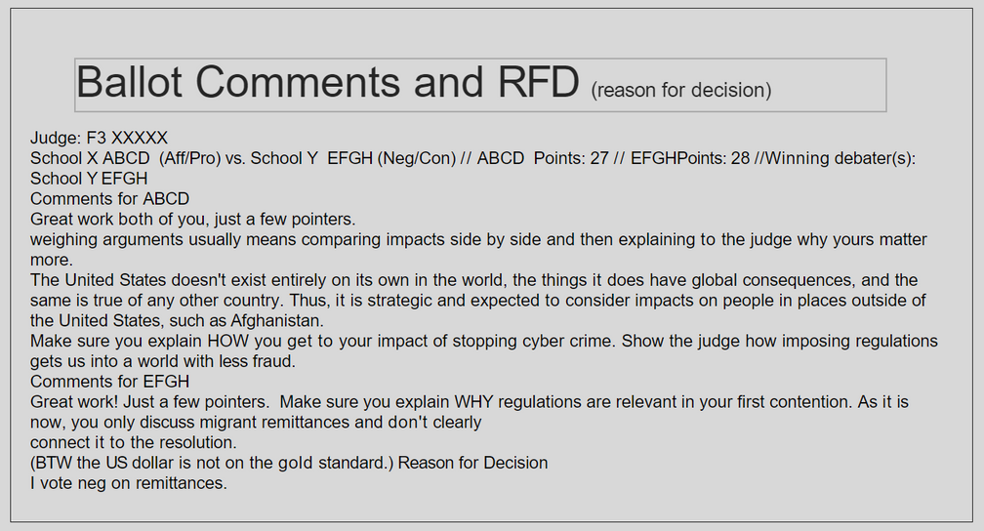
Debate Ballot Comments and RFD (Reason For Decision)​

Slide 40
World Schools Debate
  World Schools Debate is a three-on-three format. While a given team may consist of five members, only three students from a team participate in a given debate.
  Resolutions come in two types: prepared motions and impromptu motions.
  Teams will be assigned one of two sides in each round- either the government team proposing the motion or the opposition team advocating the rejection of the motion.
  Debaters present their position on a topic, refute their opponents, and respond to questions throughout the course of the debate.

Slide 41
World Schools Debate
  The motions debated in the world schools debate are either motions or propositions of value or policy.
  A proposition of value will ask debaters to qualify if the topic of the motion is; good or bad, or has done more harm than good, or is better than some other alternative.
  A policy motion will ask the debaters to create an actual policy that will improve or solve a certain economic, political, or social situation given in the motion to be debated.
  The Proposition team will bring forth a reasonable policy that will solve the problem that is given or being discussed in the motion.
  The Opposition team can choose to engage with the efficacy of the Proposition team’s “model” or “mechanism” that they’ve given to solve the problem, or the Opposition team can offer a solution of their own which they will argue actually solves the problem(s) better than the Proposition team’s mechanism or model.

Slide 42
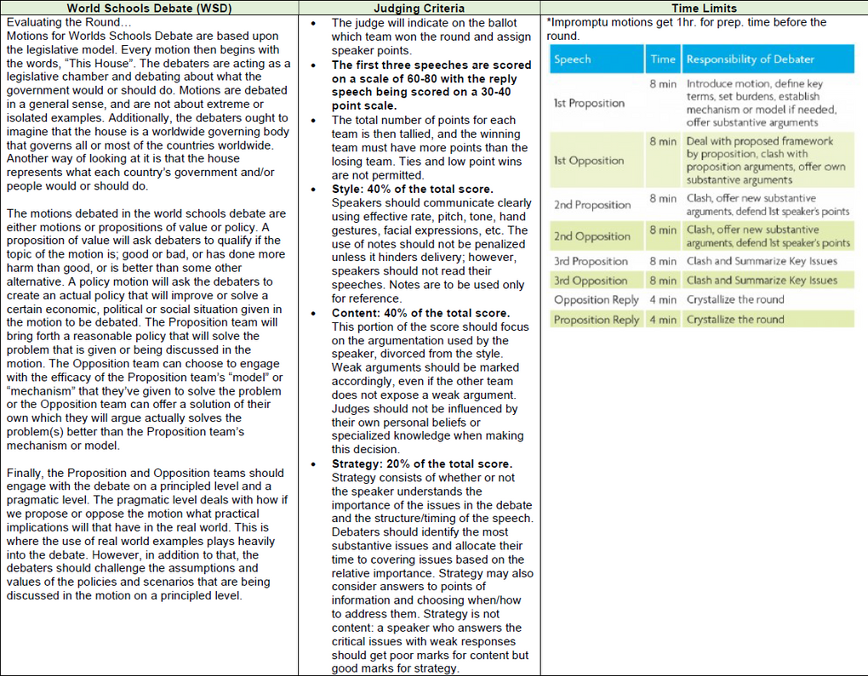
World Schools Debate
Cheat Sheet

Slide 43
Policy Debate
  Policy Debate is a two-on-two debate where an affirmative team proposes a plan, and the negative team argues why that plan should not be adopted.
  The topic for Policy Debate changes annually, so debaters throughout the course of the year will debate the same topic.
  One member of each team will perform the ‘first’ speeches, the other the ‘second’ speeches.
  So the person who reads the 1AC wil also perform the 1AR, for example.
  Note that the debate begins with the affirmative speaking first, and then switches midway through the debate where the negative speaks first, thus giving the affirmative the ability to speak last.

Slide 44
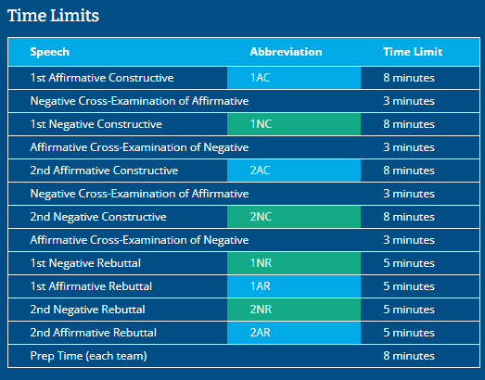
Policy Debate

Slide 45
Big Questions Debate
  Big Questions Debate is a debate format that allows students to debate with a partner or as an individual.
  Debates may be one-on-one, two-on-two, or two-on-one. Topics last all year and concern the intersection of science, philosophy, and religion.
  Students are assigned a side of the topic before each round and present cases, engage in rebuttal and refutation and participate in a question period.
  Each team is entitled to three minutes of prep time during the round.

Slide 46
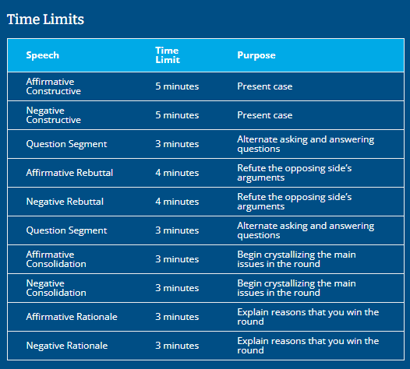
Big Questions Debate

Slide 47
Final Reminders for Debate Judges
  Do take notes.​
  All of us have various thoughts and ideas about the topics. Please do not allow your personal opinions to get in the way of the debate. Students should be debating each other, not the judge’s bias.​
  Do not penalize kids for things that they have no control over.​
  Comments should be about arguments, analysis, refutation, weighing, skills in persuasion, conﬁdence, etc.​
  Comments should NOT be about appearance, pitch level of voice, shoes, hair, etc.

